Slide 1


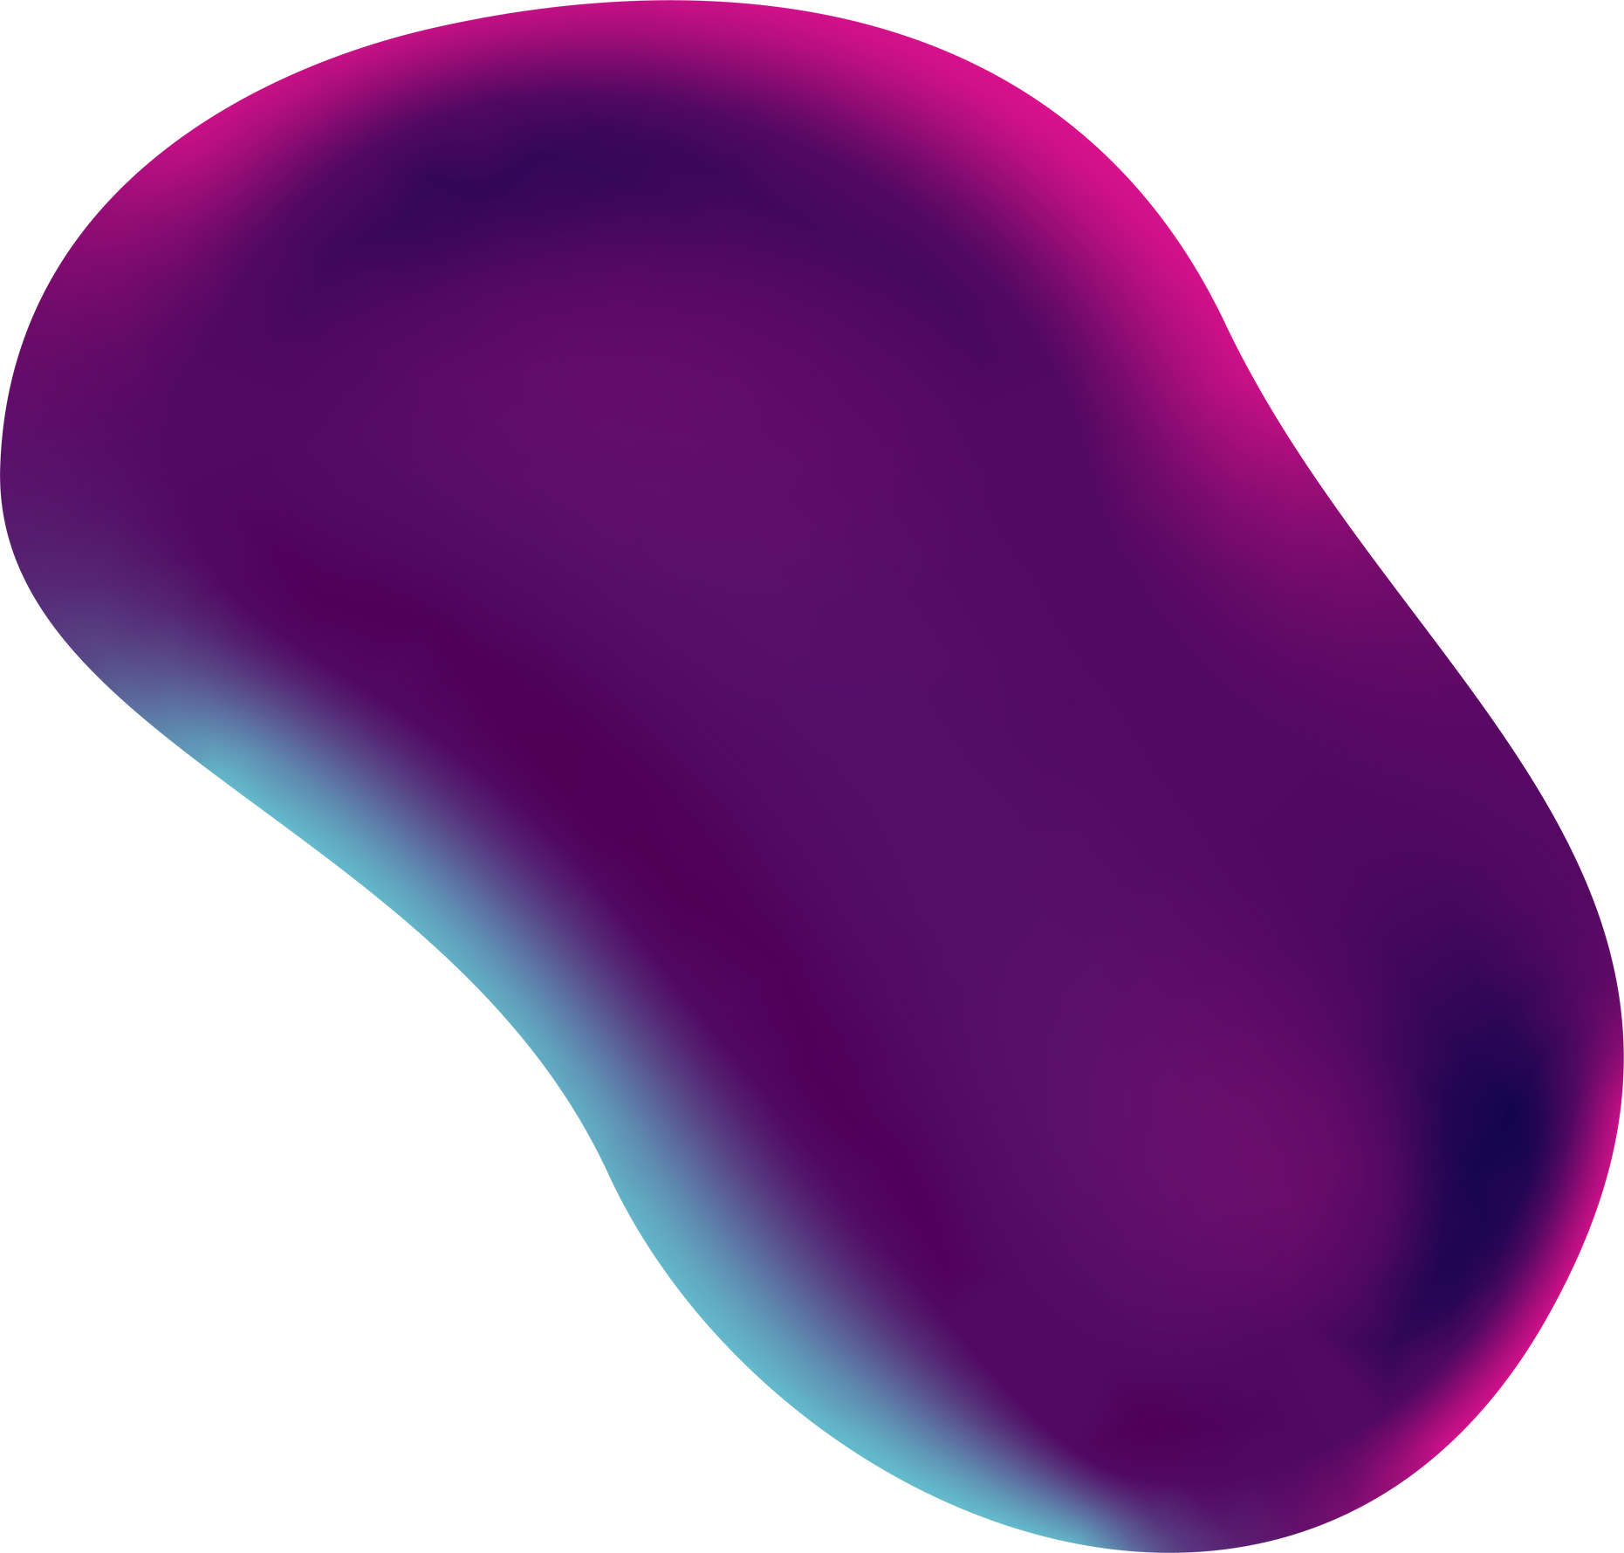
CONTROLLING GAMES
Using Hand Gestures

Slide 2


TEAM MEMBERS :
Subhadeep Das 2105931
Argha Roy 2105949
Aritra Datta 21051722
Tuhin Hazra 21052292
Soubhagya Mukherjee 21052795

Slide 3

Table of
CONTENTS
01
02
03
04
05
Introduction & Overview
Hardware and
Software Requirements
Terns &
concpets used
Basic Concepts
and Theories
Tools
Used
06
07
08
09
10
Design &
Workflow
Model
Comparison
Standards
adopted
conclusion &
future scope
Testing &
Verification

Slide 4
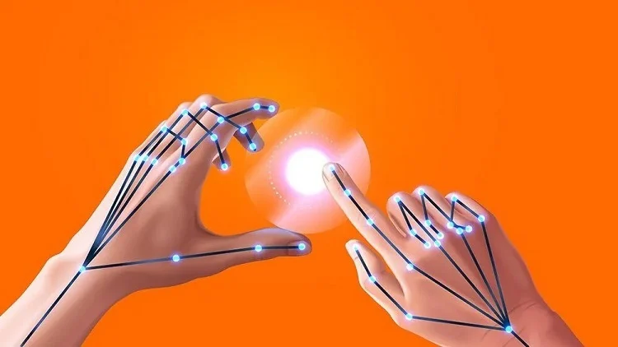
A
BRIEF OVERVIEW :
This project focuses on developing a gesture-based control system using deep learning and computer vision. The system leverages Convolutional Neural Networks (CNNs) & LSTM. It integrates OpenCV and MediaPipe for efficient hand tracking and processing. With this system you can control any game , control any social media platforms and various other applications with your hands.

Slide 5

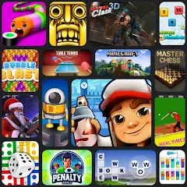
THE
MOTIVATION
Enables intuitive, touch-free control of applications
Enhances gaming experiences by replacing physical controllers
Allows seamless control of apps, slideshows, and smart devices.
Leverages advancements in real-time hand tracking
Introduces futuristic and engaging ways to interact with technology

Slide 6
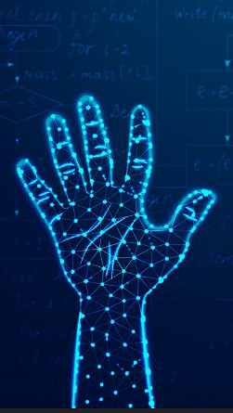




REQUIREMENTS
HARDWARE
SOFTWARE
Intel i5/i7 or AMD Ryzen or Higher
TensorFlow & Keras
System Type: 64-Bit , x64-based processor
OpenCV & Mediapipe
1080p or higher resolution camera
Anaconda Environment
256GB SSD or more.
Python 3.8 or Higher
Minimum 8 GB RAM
PyCharm / VS Code

Slide 7
Concepts Used
Machine Learning & Deep Learning
Human-Computer Interaction
Computer Vision
Detecting and tracking hand movements using OpenCV and MediaPipe. Identifying hand landmarks such as fingertips, palm center, and joint positions.
Convolutional Neural Networks (CNNs) & LSTM for feature extraction from hand images. Image preprocessing techniques like filtering, contour detection, and thresholding.
Enabling users to control games, social media, and other applications through gestures
& improving accessibility and user experience through touchless interaction.

Slide 8

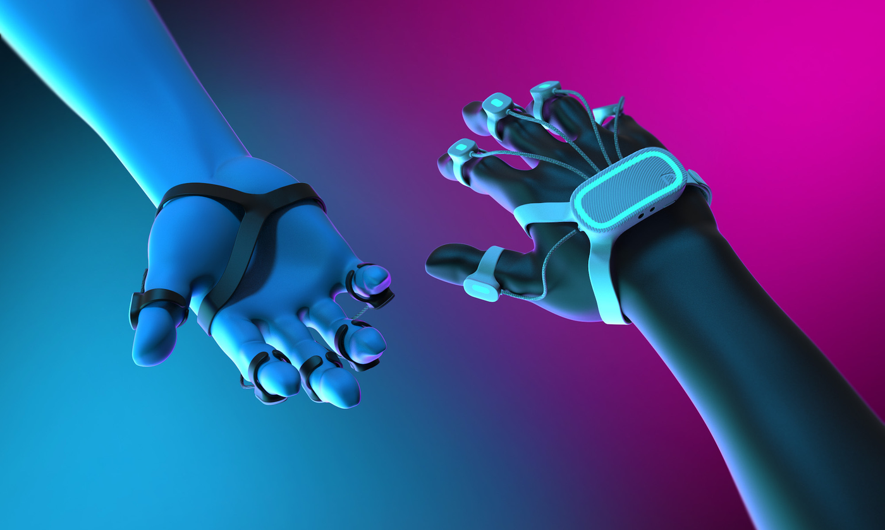
TERMS
YOU SHOULD KNOW!
PIPELINE
MEDIAPIPE
Refers to a sequence of interconnected steps or processes that collectively accomplish a specific task or objective.
Open source, cross-platform framework for processing multimedia data like video and audio
CVZONE
LANDMARKS
Provides a library for simplified computer vision applications, offering pre-built modules for tasks
Represents key points in sequential data, crucial for capturing temporal dependencies and informing predictions
INFERENCE
INEURAL NETWORKS
The process of making predictions or drawing conclusions based on available evidence or data.
A type of machine learning process, that uses interconnected nodes or neurons in a layered structure that resembles the human brain.

Slide 9


TOOLS
USED
LSTM
& CNN
processes sequential input data that is obtained from the camera stream to enable real-time hand sign identification, enabling the system to map hand movements to system commands.
it is a powerful automation library that allows developers to control the mouse and keyboard, capture screenshots, and perform various GUI automation tasks effortlessly
PyAutoGUI

Slide 10









Design &
Workflow
METHODOLOGY
INPUT COLLECTION
GESTURE RECOGNITION
SYSTEM INTEGRATION
DEPLOY
Creating a real-time gesture recognition system for hand gestures in webcam video feeds, aiding human-computer interaction and sign language recognition.
Real-time hand gesture data collection via webcam using OpenCV and MediaPipe libraries for landmark extraction and hand detection.
Preprocessing extracts hand landmarks from video data using MediaPipe, serving as input for a CNN model in the gesture recognition model.
Checks the position of key hand landmarks like the index finger and palm center to recognize gestures. Each gesture corresponds to a specific directional input such as decreasing or increasing X or Y cordinates and fed into the corresponding keys
The trained model is serialized for deployment, facilitating integration into real-time applications for hand gesture communication, with plans for future interface development and API integration.

Slide 11
Which one is better ?
For this project, CNN is the better choice over LSTM.
Higher Accuracy (Project uses static data )
Faster Processing
Lower Computational Cost
Better Robustness
More Suitable for Static Gestures

Slide 12
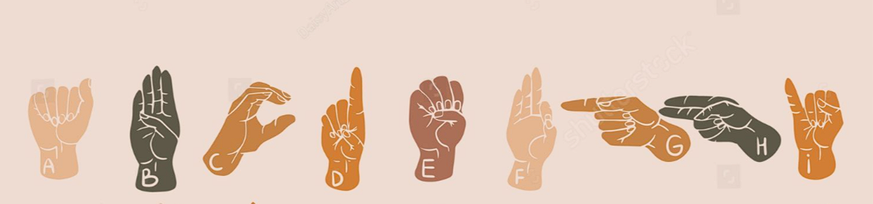
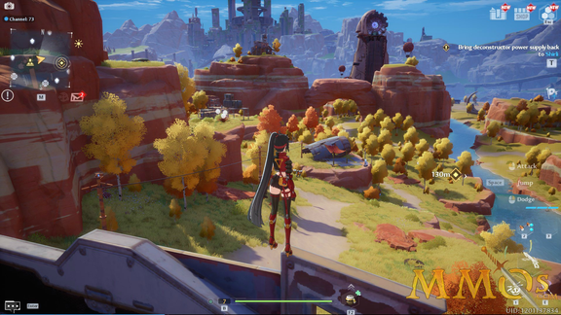

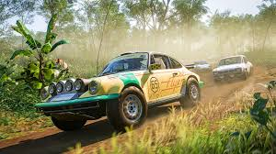
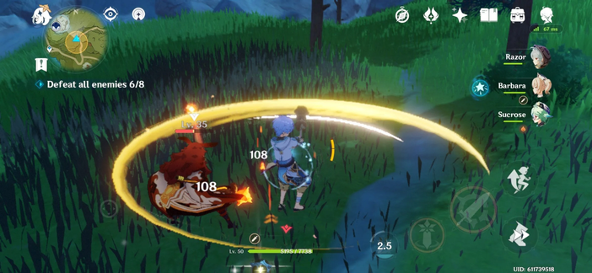

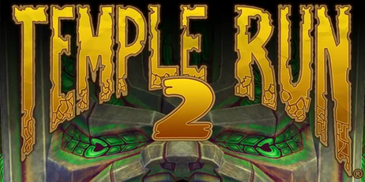
TESTING & VERIFICATION
PHASE 1 : Testing
Testing includes webcam functionality validation, pipeline verification, CNN model training validation, deployment testing, system integration testing, and user evaluation for real-time hand gesture recognition system.
PHASE 2 : Verification
● User acceptance testing has been conducted with target users, and the system has demonstrated effectiveness, usability, and user satisfaction.

Slide 13

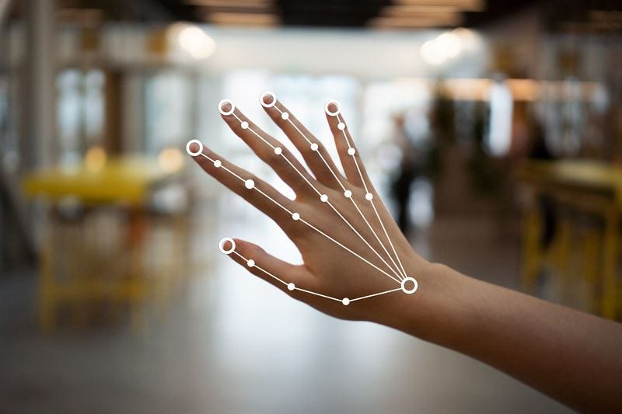
STANDARDS ADOPTED
Modularity , Reusability , Readability
Error Handling , Encapsulation ,
Consistency , Variable Naming
Function Naming , Constants
Whitespace , Imports
DESIGN
STANDARDS
Unit Testing , Integration Testing , Manual Testing , Boundary Testing , Performance Testing , Code Review
TESTING
STANDARDS

Slide 14

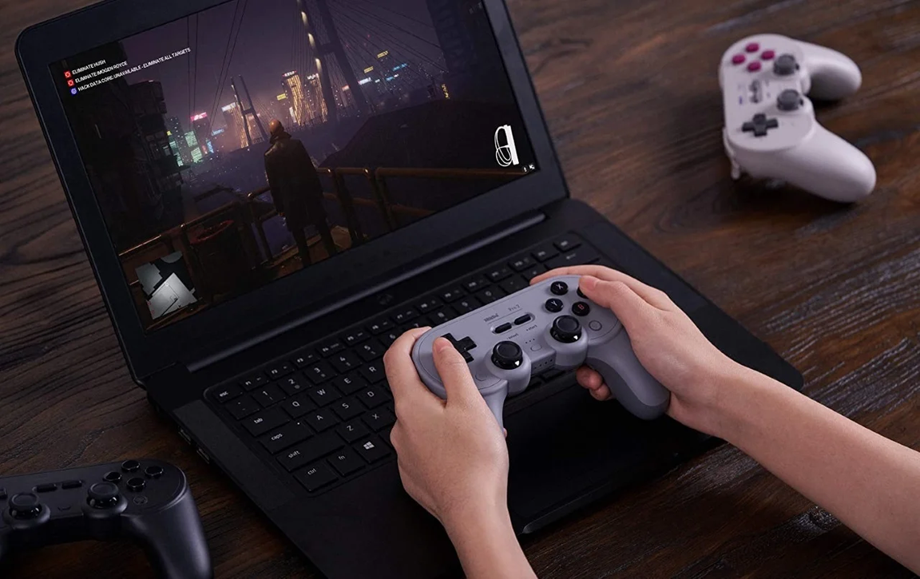
CONCLUSION &
FUTURE SCOPE
By using real-time hand tracking and recognition it allows users to interact with applications like games and social media through intuitive hand movements.
By leveraging computer vision and machine learning, it enhances accessibility and provides a hands-free user experience.
In the future, the system can be improved with better accuracy, multi-hand detection, and AI-driven adaptive learning, integration with VR/AR, IoT devices, and smart home automation.

Slide 15
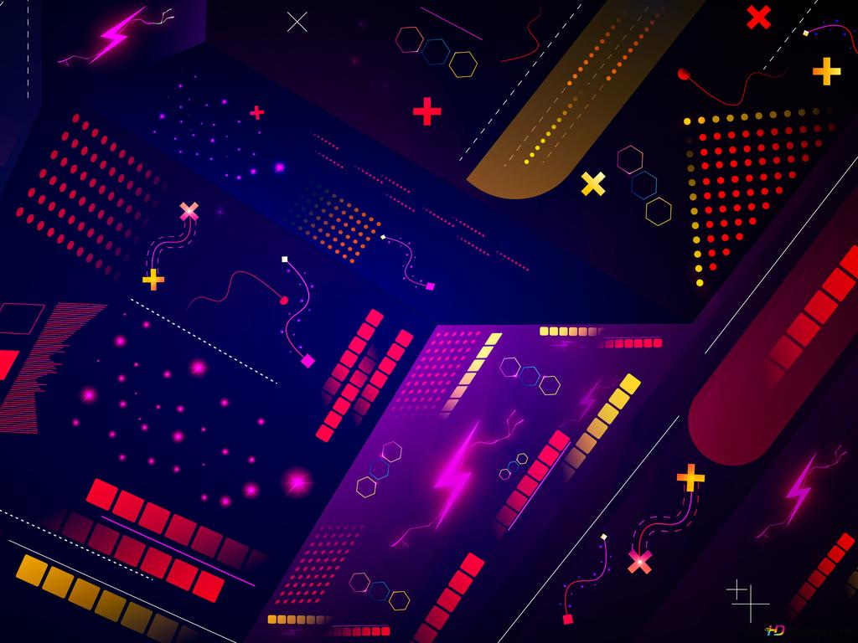

THANK YOU
FOR WATCHING THE
PRESENTATION

